Slide 1
Priority queue

Slide 2
What is a priority queue?
A priority queue is an abstract data type that behaves similarly to the normal queue except that each element has some priority, i.e., the element with the highest priority would come first in a priority queue. The priority of the elements in a priority queue will determine the order in which elements are removed from the priority queue.

Slide 3
Characteristics of a Priority queue
Every element in a priority queue has some priority associated with it.
An element with the higher priority will be deleted before the deletion of the lesser priority.
If two elements in a priority queue have the same priority, they will be arranged using the FIFO principle.

Slide 4
Let's understand the priority queue through an example.
We have a priority queue that contains the following values:
1, 3, 4, 8, 14, 22
All the values are arranged in ascending order. Now, we will observe how the priority queue will look after performing the following operations:
poll(): This function will remove the highest priority element from the priority queue. In the above priority queue, the '1' element has the highest priority, so it will be removed from the priority queue.
add(2): This function will insert '2' element in a priority queue. As 2 is the smallest element among all the numbers so it will obtain the highest priority.
poll(): It will remove '2' element from the priority queue as it has the highest priority queue.
add(5): It will insert 5 element after 4 as 5 is larger than 4 and lesser than 8, so it will obtain the third highest priority in a priority queue.

Slide 5
Types of Priority Queue
There are two types of priority queue:
Ascending order priority queue
Descending order priority queue

Slide 6
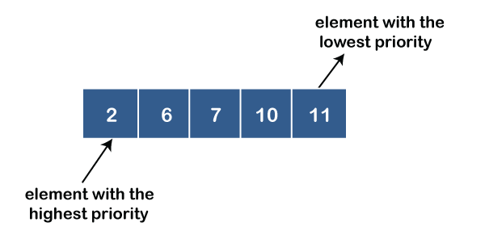
Ascending order priority queue
In ascending order priority queue, a lower priority number is given as a higher priority in a priority. For example, we take the numbers from 1 to 5 arranged in an ascending order like 1,2,3,4,5; therefore, the smallest number, i.e., 1 is given as the highest priority in a priority queue.

Slide 7
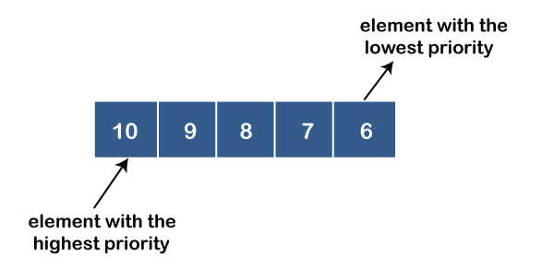
Descending order priority queue
In descending order priority queue, a higher priority number is given as a higher priority in a priority. For example, we take the numbers from 1 to 5 arranged in descending order like 5, 4, 3, 2, 1; therefore, the largest number, i.e., 5 is given as the highest priority in a priority queue.

Slide 8
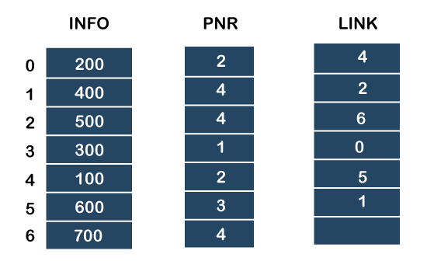
Representation of priority queue
We will create the priority queue by using the list given below in which INFO list contains the data elements, PRN list contains the priority numbers of each data element available in the INFO list, and LINK basically contains the address of the next node.

Slide 9
Let's create the priority queue step by step.
In the case of priority queue, lower priority number is considered the higher priority, i.e., lower priority number = higher priority.
Step 1: In the list, lower priority number is 1, whose data value is 300, so it will be inserted in the list as shown in the below diagram:
Step 2: After inserting 300, priority number 2 is having a higher priority, and data values associated with this priority are 200 and 100. So, this data will be inserted based on the FIFO principle; therefore 200 will be added first and then 100.
Step 3: After inserting the elements of priority 2, the next higher priority number is 4 and data elements associated with 4 priority numbers are 400, 500, 700. In this case, elements would be inserted based on the FIFO principle; therefore, 400 will be added first, then 500, and then 700.
Step 4: After inserting the elements of priority 4, the next higher priority number is 5, and the value associated with priority 5 is 600, so it will be inserted at the end of the queue.

Slide 10
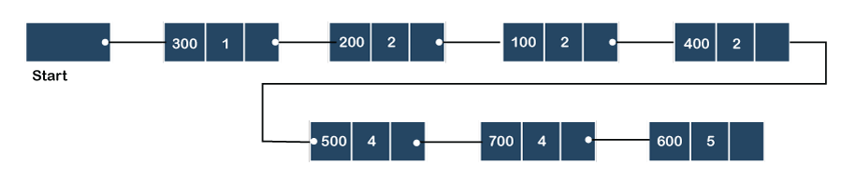

Slide 11
Implementation of Priority Queue
The priority queue can be implemented in four ways that include arrays, linked list, heap data structure and binary search tree.

Slide 12
Analysis of complexities using different implementations
Implementation | add | Remove | peek
Linked list | O(1) | O(n) | O(n)
Binary heap | O(logn) | O(logn) | O(1)
Binary search tree | O(logn) | O(logn) | O(1)

Slide 13
Applications of Priority queue
The following are the applications of the priority queue:
It is used in the Dijkstra's shortest path algorithm.
It is used in prim's algorithm
It is used in data compression techniques like Huffman code.
It is used in heap sort.
It is also used in operating system like priority scheduling, load balancing and interrupt handling.

